Slide 1


Selective withdrawal Workshop
UNCLASSIFIED
Zhonglong Zhang, PhD, PE, PH
Portland State University
CE-QUAL-W2 Workshop
August 16 - 18, 2022
Environmental Systems
Modeling Team
UNCLASSIFIED

Slide 2
Objectives
This case study is used to demonstrate selective withdrawal blending algorithms in W2 V4.5 model. The W2 model estimates the temperatures released by those flows through the priority outlets, then adjusts the temperature target for the blended releases accordingly.
Detroit lake impounds 455,100 acre-ft of water at full pool, making it one of the largest reservoirs in the Willamette River Basin. The North Santiam River is one of several major tributaries to the Willamette River. The fixed-elevation outlet was given a centerline elevation of 408.4 m (1,340 ft). The floating outlet was given a depth (DEPTH) of 2 m (6.56 ft) and a minimum flow of 11.327 m3/s (400 ft3/s).
Sullivan, A.B., Rounds, S.A., Sobieszczyk, S., and Bragg, H.M., 2007, Modeling hydrodynamics, water temperature, and suspended sediment in Detroit Lake, Oregon: U.S. Geological Survey Scientific Investigations Report 2007–5008
Notes:
TDG supersaturation in waters has been identified as one of the possible negative environmental effects of dams

Slide 3
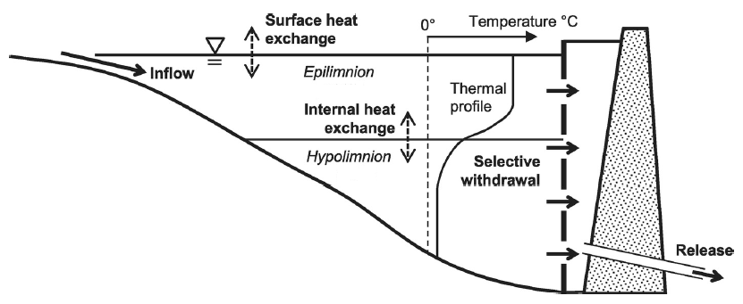
Selective Withdrawal
Selective withdrawal uses stratified flow to pull out water from selected depths of the pool.
Selective withdrawal flow depends upon the discharge, stratification, geometry of the outlet, bathymetry of the impoundment, and any in-reservoir circulation.
Notes:
TDG is the amount of gas present in water, mainly nitrogen and oxygen.

Slide 4
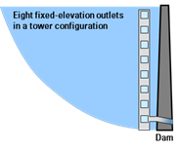
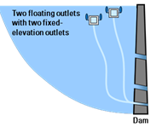
Selective Withdrawal
The first algorithm allows a single structure or withdrawal up to 10 discrete elevations to which it can be set.
The second algorithm allows the blending of releases from 2 specified structures or withdrawals to match a user-specified release temperature.
Blending algorithms will allow more complicated dam-operation scenarios to be evaluated somewhat automatically with the model
USGS blending algorithm allows blending 10 outlets to meet a user-specified temperature target, and additional user inputs are required to specify the depth of floating outlets, optional constraints on minimum and maximum head and release rates for each outlet, and a priority ranking for each outlet, among others.

Slide 5
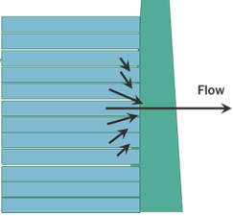
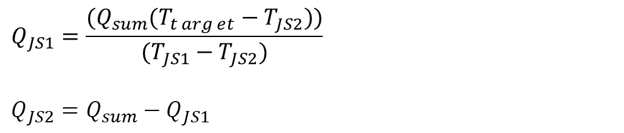
Selective Withdrawal
Rules for selective withdrawal when there are two outlets where flow is being split
If T_{JS1}> T_{target} and T_{JS2}> T_{target}, take all flow from lower outlet (JS2)
If T_{JS1}<T_{target} and T_{JS2}< T_{target}, take all flow from upper outlet (JS1)
If T_{JS1}>T_{target} and T_{JS2}< T_{target}, take apportion flow based on flow balance equation
$$Q_{JS1}=\frac{(Q_{sum}(T_{t\arg{e}t}−T_{JS2}))}{(T_{JS1}−T_{JS2})}$$
$$Q_{JS2}=Q_{sum}−Q_{JS1}$$
If water elevation is below the outlet elevation for the upper outlet (JS1), take all flow from the lower outlet (JS2).

Slide 6
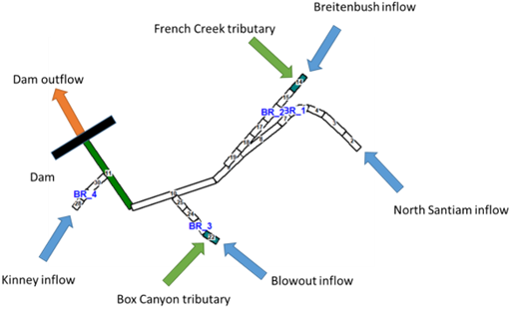
Detroit Lake Conceptual Model

Slide 7
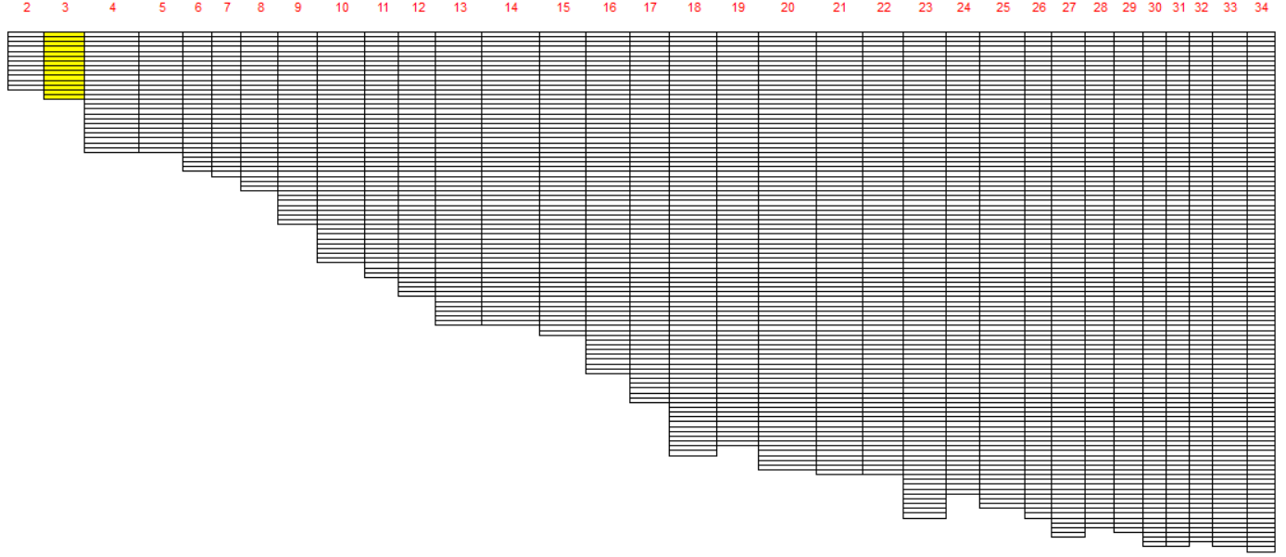
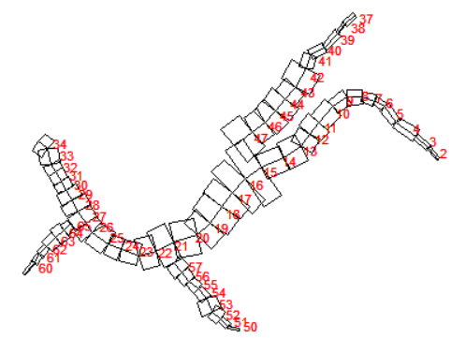
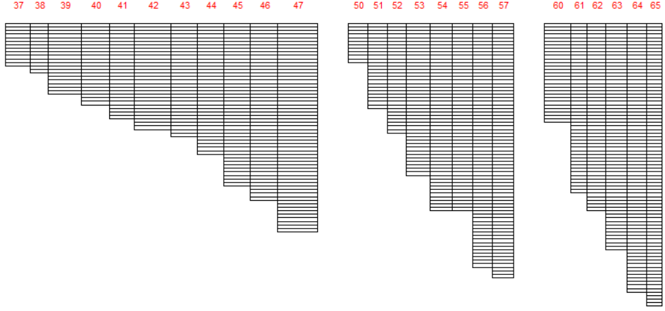
Detroit Lake Model Grids

Slide 8
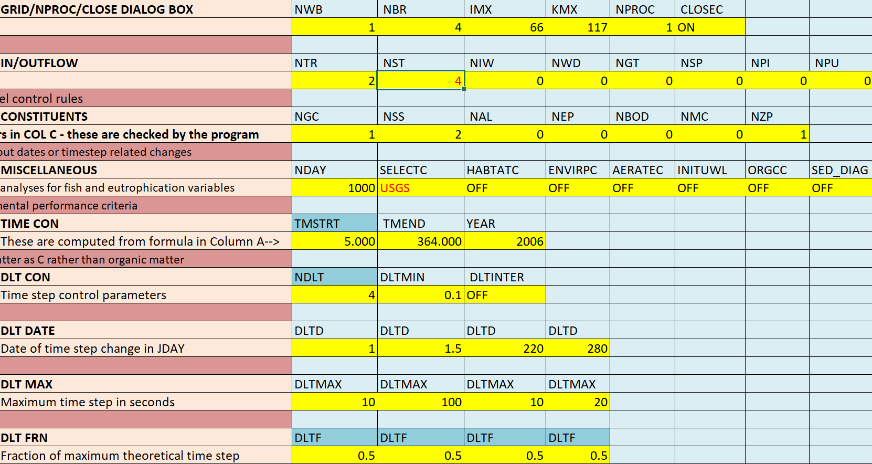
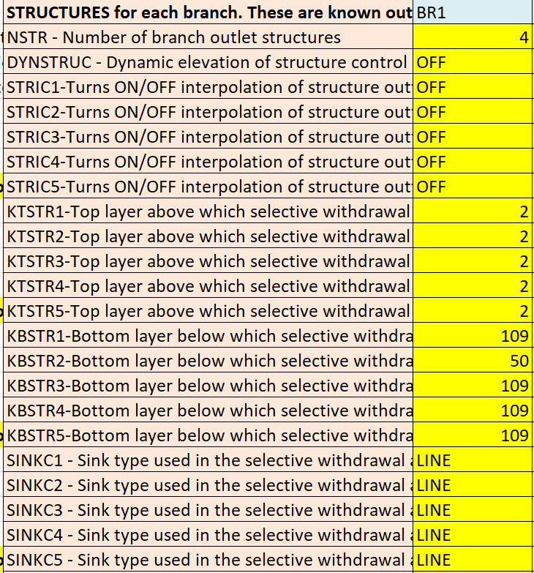
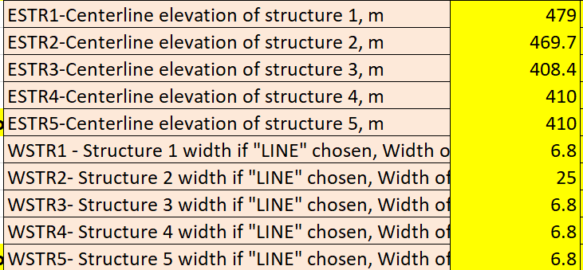
Detroit Lake Model Inputs: w2_con.csv
1: floating weir, priority 1, 2.3 m depth, minimum 400 cfs, maximum 5600 cfs
2: spillway, priority -1 (nonblended)
3: lower power outlet, priority 1, maximum 5600 cfs
4: regulating outlet, priority -1 (nonblended), maximum 5600 cfs

Slide 9
Detroit Lake Model Inputs
File type |  | File name
Wind sheltering | WSCFN | wsc.npt
Shading | SHDFN | shade.npt
Bathymetry | BTHFN | bth1.csv
Met | METFN | 0609_met_stay_raws.npt
Tributary inflow | QTRFN - tributary flow | 0609_french_q_est.npt | 0609_boxCan_q_est.npt
 | TTRFN - tributary temp | 0609_french_t_est.npt | 0609_boxCan_t_est.npt
Branch inflow | QINFN branch inflow | 0609_nsboulder_q.npt | 0609_breitenbush_q.npt | 0609_blowout_q.npt | 0609_kinney_q_est.npt
 | TINFN branch temp | 0609_nsboulder_t.npt | 0609_breitenbush_t.npt | 0609_blowout_t.npt | 0609_kinney_t_est.npt
 | QDTFN Distributed flow | 0609_qdt_br1_est.npt | 0609_qdt_br2.npt | 0609_qdt_br3.npt | 0609_qdt_br4.npt
 | TDTFN Distributed temp | 0609_tdt_br1_est.npt | 0609_tdt_br2.npt | 0609_tdt_br3.npt | 0609_tdt_br4.npt
Precipitation | PREFN flow | 0609_pre_detroit.npt | 0609_pre_detroit2.npt | 0609_pre_detroit3.npt | 0609_pre_detroit4.npt
 | TPRFN temp | 0609_tpr_detroit.npt | 0609_tpr_detroit2.npt | 0609_tpr_detroit3.npt | 0609_tpr_detroit4.npt
Structure outflow | QOTFN | 0609_qot_det_max.npt

Slide 10
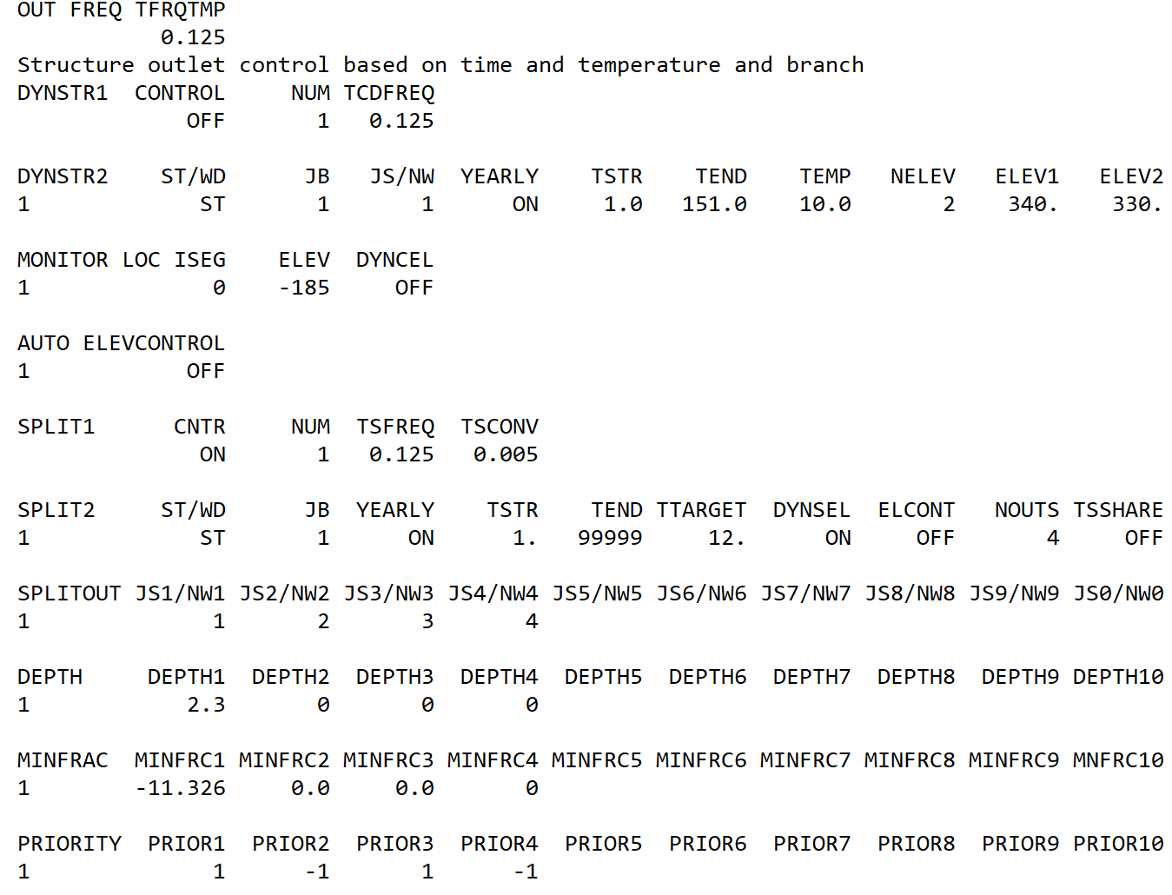
W2 Selective Inputs
w2_selective.npt

Slide 11
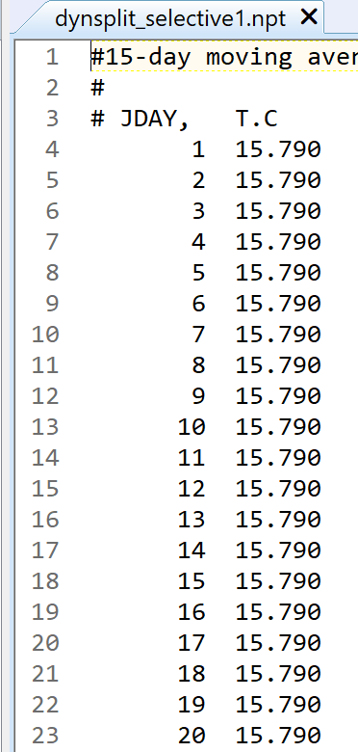
W2 Selective Inputs
dynsplit_selective1.npt

Slide 12
Model Results
Effect of dam operations on release water temperature, with and without selective withdrawal

Slide 13
Hands-On Exercises

Slide 14
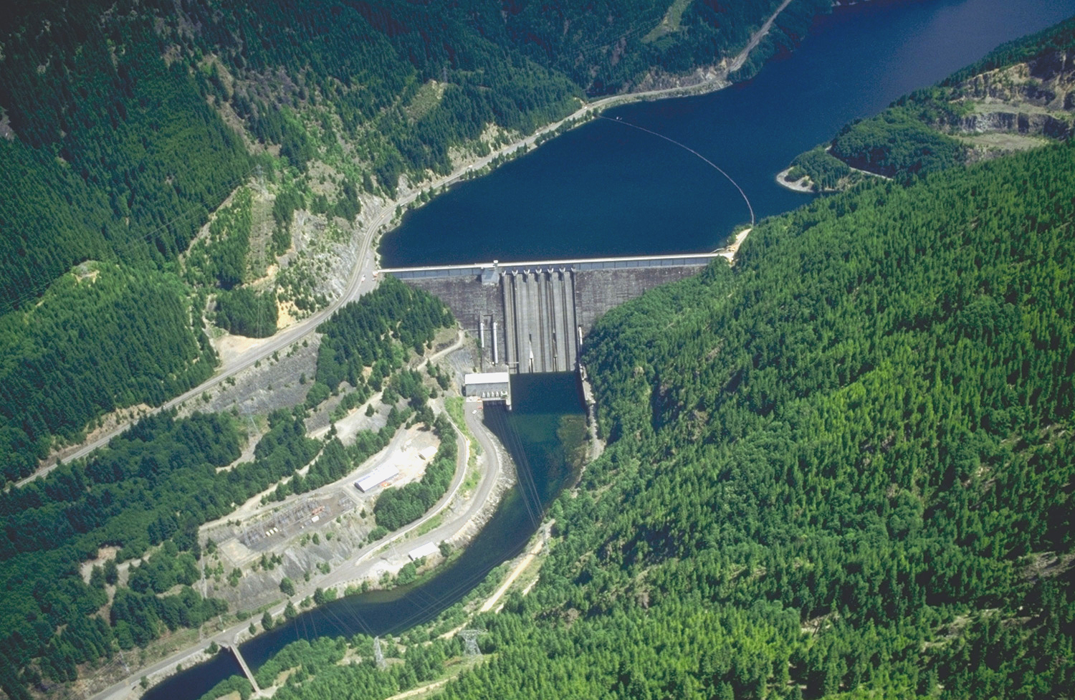
Questions?

